Slide 1

SOCIAL MEDIA SENTIMENT ANALYSIS USING DEEP LEARNING MODELS & NLP
This presentation will delve into the world of sentiment analysis on social media data, focusing on deep learning models and natural language processing techniques. We'll explore how these technologies can be used to understand the sentiment expressed in posts and comments and how this information can be applied across various domains.
Presented BY
Yashasvi Gupta 500101768 B3 AIML
Kartik Khatri 500102128 B3 AIML

Slide 2

What is sentiment analysis?
Sentiment Analysis Explained
Why is it important?
Sentiment analysis is the process of computationally determining whether a piece of writing is positive, negative, or neutral. It's also known as opinion mining, deriving the opinion or attitude of a speaker.
Sentiment analysis has wide-ranging applications in various fields, including business, politics, and public actions. It helps organizations understand public perception and make informed decisions.

Slide 3



Social Media's Role in Expressing Sentiment
Tweets & Microblogs
Detailed Posts
Comments & Discussions
Users share quick opinions and emotions via tweets, shaping public sentiment in real-time.
Longer posts allow users to elaborate on feelings, giving deeper insight into their sentiments.
Comments foster interaction, revealing public reaction and sentiment trends on topics and brands.

Slide 4

Natural Language Processing(NLP)
1
NLP's Role
2
Classical Approaches
Natural language processing (NLP) is a field of computer science and a subfield of artificial intelligence that aims to make computers understand human language.
Traditionally, NLP relied on rule-based methods, statistical methods, and classical machine learning models with handcrafted features. However, these approaches have limitations in handling complex language nuances and understanding context.

Slide 5
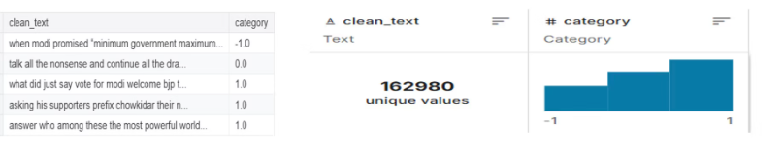
DATASET OVERVIEW
This is an entity-level sentiment analysis dataset of twitter. Given a message and an entity, the task is to judge the sentiment of the message about the entity.
There are three classes in this dataset: Positive, Negative and Neutral. We regard messages that are not relevant to the entity (i.e. Irrelevant) as Neutral
Social Media Sentiment Analysis
Entity-Level Sentiment
Social Media is a rich source of data for sentiment analysis. Its vast user base generates a massive amount of text data that can be analyzed to understand public sentiment on various topics.
The dataset we're using is an entity-level sentiment analysis dataset of Social Media, where the goal is to determine the sentiment of a tweet about a specific entity. This dataset is crucial for understanding how people feel about particular brands, products, or individuals.

Slide 6
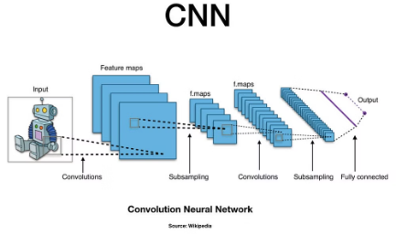
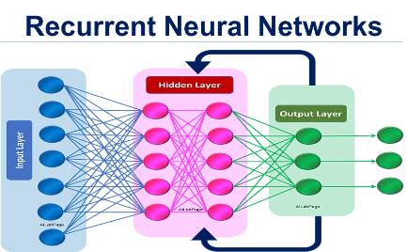
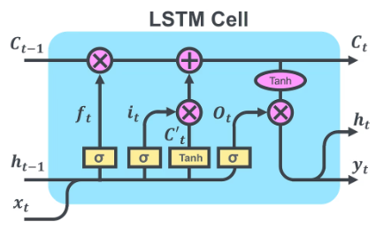
Deep Learning Models
CNN (Convolutional Neural Network)
RNN (Recurrent Neural Network)
LSTM (Long Short-Term Memory)
CNNs excel at detecting local features and patterns in data by applying convolutional filters. Originally developed for image recognition, CNNs have been successfully adapted for natural language processing tasks, such as text classification and sentiment analysis, where they capture important phrases and contextual signals within fixed-size windows.
RNNs are designed to handle sequential data by maintaining a hidden state that carries contextual information through time steps. This makes them particularly good at understanding the order and dependencies in text, allowing the network to model complex sequences such as sentences or conversations. However, traditional RNNs can struggle with very long sequences due to vanishing gradient issues.
LSTMs are a type of RNN designed specifically to address the limitations of traditional RNNs, especially their difficulty in remembering long-term dependencies. By using specialized gating mechanisms, LSTMs can selectively store, retain, and retrieve information over long sequences, which enables them to capture complex sentence structures, context, and semantics in natural language processing tasks such as sentiment analysis and machine translation.

Slide 7

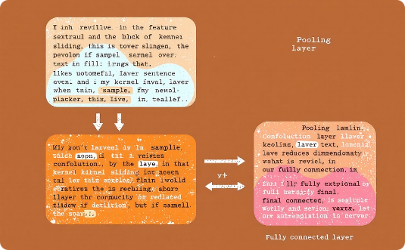
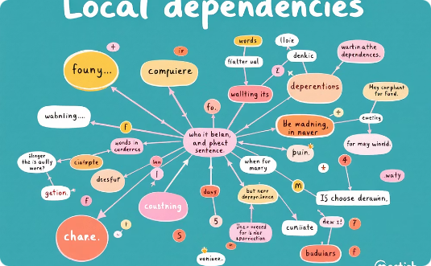
Why Use CNN?
Excels at recognizing patterns in text like image recognition
Effective at extracting important features from text
Captures local dependencies to grasp context and meaning

Slide 8







Steps for CNN Implementation
1. Preprocessing
The first step involves cleaning, tokenizing, and padding the text data. This step prepares the data for the deep learning model.
2. Embedding
Convert words into meaningful vector representations using techniques like Word2Vec, GloVe, or trainable embeddings. Embeddings capture the semantic relationships between words.
3. CNN Architecture
Build the CNN architecture, which typically involves convolutional layers (Conv1D), max pooling, and dense layers. These layers extract features from the text and learn to classify the sentiment.
4. Model Compilation
Compile the model using an optimizer like Adam and a loss function like binary cross-entropy. This sets up the model for training.
5. Model Training
Train the model on labeled sentiment data. The model learns to identify patterns in the data and make accurate predictions.
6. Evaluation
Evaluate the model's performance using metrics like accuracy, precision, and recall. This assesses how well the model performs on unseen data.
7. Prediction
Use the trained model to predict sentiments on new text. This is where the real-world application of sentiment analysis comes in.

Slide 9

Limitations of CNN
Local Patterns
Sentence Structure
CNNs focus primarily on local patterns within text, which can limit their ability to understand long-term dependencies or complex sentence structures.
When dealing with complex sentence structures where the meaning depends on the order of words or phrases, CNNs may struggle to capture the nuances of the language.

Slide 10
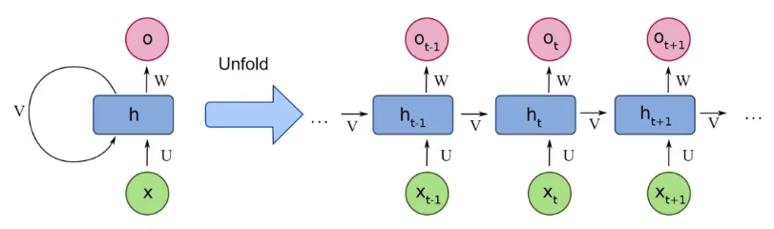
Implementing RNN for Sentiment Analysis
Recurrent Neural Networks (RNNs) process text sequentially, maintaining context across words.
They excel in capturing long-term dependencies to understand sentiment flow.
RNNs are well-suited for sentiment classification by analyzing sentence order and context.

Slide 11
Implementing RNN for Sentiment Analysis
1. Text to Sequences
The first step involves converting the text into sequences of numerical values, where each word is represented by a numerical index. This step prepares the data for processing by the RNN.
2. Embedding Layer
Use an embedding layer to transform these word indices into meaningful vector representations. This layer captures the semantic relationships between words.
3. Recurrent Layers
The core of the RNN model consists of recurrent layers that process these sequential input data. RNNs are designed to learn long-term dependencies in the text.
4. Sentiment Prediction
The RNN layers process the input sequences and predict the sentiment based on the learned patterns.
5. Predictions
The model's predictions are outputted in a format that can be used for analysis or decision-making.

Slide 12
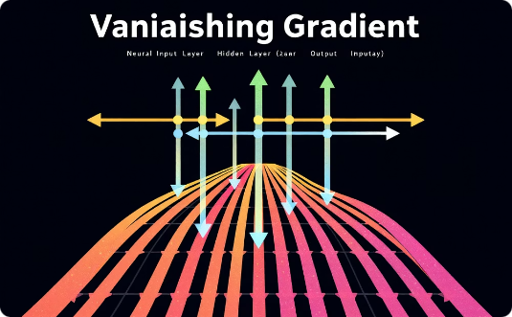

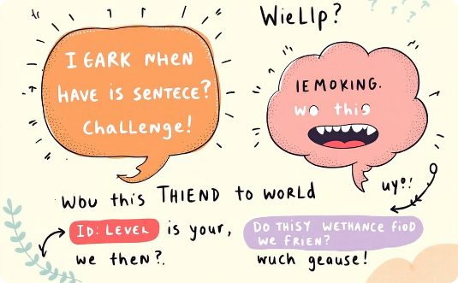
Limitations of RNN
Vanishing Gradient
Long-Term Dependencies
Complex Structures
The gradient signal weakens during training, making it hard for RNNs to learn long-term dependencies.
RNNs often struggle to retain information across long sequences, especially with extended sentences.
RNNs may not capture subtle language nuances as effectively as LSTMs in complicated sentences.

Slide 13

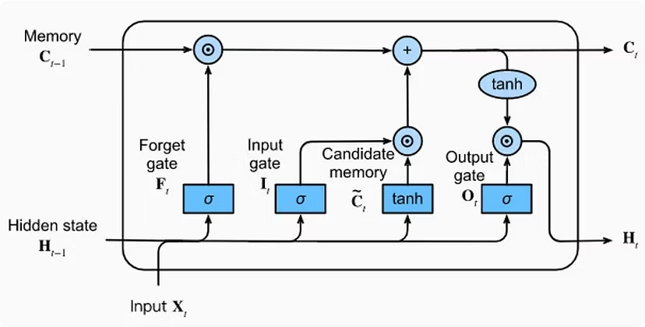
Understanding & Implementing LSTM
LSTMs have gained popularity due to their ability to overcome the limitations of traditional RNNs. The key innovation of LSTMs lies in their special memory cell structure. This cell allows LSTMs to selectively remember or forget information over extended periods, making them well-suited for capturing long-term dependencies in text.

Slide 14
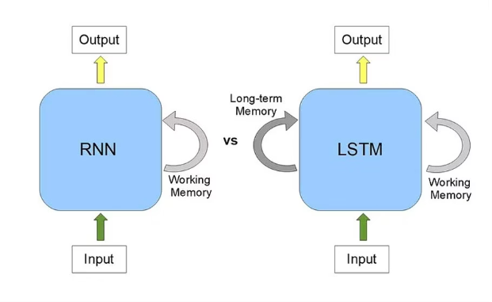
Why Use LSTM?
Long Short-Term Memory (LSTM) is a type of Recurrent Neural Network (RNN) designed to handle sequential data. Unlike standard RNNs, LSTMs can remember long-term dependencies using a memory cell. Useful in NLP tasks like machine translation, speech recognition, and sentiment analysis
Memory Cell
Overcoming RNN Limits
Applications in NLP
LSTMs contain memory cells that store information for
They solve the vanishing gradient problem in traditional RNNs.
Well-suited for complex tasks like speech recognition and sentiment analysis.
long periods.

Slide 15
Key Fundamentals of LSTM
Memory Cell State
Acts as a long-term storage unit, allowing LSTMs to retain important information from previous time steps while discarding irrelevant details
LSTMs are able to maintain information over long periods of time through their memory cells, allowing them to capture dependencies in text effectively. This capability makes LSTMs especially useful in natural language processing tasks.LSTMs use gates to regulate the flow of information, ensuring effective learning and long-term dependency handling.
Forget Gate
Input Gate
Output Gate
Decides what information to discard from the previous cell state by applying a sigmoid activation function
Determines which new information should be added to the cell state using a combination of sigmoid and tanh functions
Generates the final output by applying a transformation to the updated cell state and controlling what is carried forward to the next time step

Slide 16


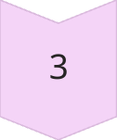
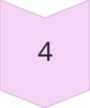

Steps for Implementing LSTM in Sentiment Analysis
Data Preprocessing
Tokenize text, convert to sequences, and pad inputs for uniform length.
Embedding Layer
Transform word indices into dense vectors capturing semantic relationships.
LSTM Layer(s)
Use memory cells and gates to capture long-term sequence dependencies.
Fully Connected Layer
Apply dense layer with sigmoid activation for binary sentiment output.
Training & Evaluation
Train model on labeled data, evaluate with accuracy and loss metrics.

Slide 17




Conclusion: Leveraging Deep Learning for Sentiment Analysis
Deep Learning Advantage
Practical Impact
Ongoing Challenges
Future Directions
Sentiment analysis drives decisions across marketing and public policy.
Improving model complexity and data quality remains vital.
Combining contextual knowledge with real-time data for greater accuracy.
Advanced models like LSTM capture intricate language patterns and sentiments.

